Slide 1

Simulating DDoS Attacks to Test Server Resilience
KLE Technological
University
Dr. M. S. Sheshgiri Campus, Belagavi
Department of Computer Science & Engineering
Creating Value
Leveraging Knowledge
TEAM A-3
NAME | SRN
Mohd. Qadir T | 02FE22BCS053
Aisha K | 02FE22BCS009
Vanashree A N | 02FE22BCS171
Niranjan D | 02FE22BCS059
Under the Guidance of Prof. Vaishali Parab

Slide 2

Index
Background 1
_ _ _ _ _ _ _ _ _ _ _ _ _ _ _ _ _ _ _ _ _ _ _ _ _ _ _ _ _ _ _ _ _ _ _ _ _ _ _ _ _ _ _
Motivation 2
_ _ _ _ _ _ _ _ _ _ _ _ _ _ _ _ _ _ _ _ _ _ _ _ _ _ _ _ _ _ _ _ _ _ _ _ _ _ _ _ _ _ _
Literature Survey 3-7
_ _ _ _ _ _ _ _ _ _ _ _ _ _ _ _ _ _ _ _ _ _ _ _ _ _ _ _ _ _ _ _ _ _ _ _ _ _ _ _ _ _ _
Gaps In Literature 8
_ _ _ _ _ _ _ _ _ _ _ _ _ _ _ _ _ _ _ _ _ _ _ _ _ _ _ _ _ _ _ _ _ _ _ _ _ _ _ _ _ _ _
Objectives 9
_ _ _ _ _ _ _ _ _ _ _ _ _ _ _ _ _ _ _ _ _ _ _ _ _ _ _ _ _ _ _ _ _ _ _ _ _ _ _ _ _ _ _
Gantt Chart 10
_ _ _ _ _ _ _ _ _ _ _ _ _ _ _ _ _ _ _ _ _ _ _ _ _ _ _ _ _ _ _ _ _ _ _ _ _ _ _ _ _ _ _
Functional Requirements 13-14
_ _ _ _ _ _ _ _ _ _ _ _ _ _ _ _ _ _ _ _ _ _ _ _ _ _ _ _ _ _ _ _ _ _ _ _ _ _ _ _ _ _ _
Non Functional Requirements 15
_ _ _ _ _ _ _ _ _ _ _ _ _ _ _ _ _ _ _ _ _ _ _ _ _ _ _ _ _ _ _ _ _ _ _ _ _ _ _ _ _ _ _
High Level Design 16-17
_ _ _ _ _ _ _ _ _ _ _ _ _ _ _ _ _ _ _ _ _ _ _ _ _ _ _ _ _ _ _ _ _ _ _ _ _ _ _ _ _ _ _
Low Level Design 18-21
_ _ _ _ _ _ _ _ _ _ _ _ _ _ _ _ _ _ _ _ _ _ _ _ _ _ _ _ _ _ _ _ _ _ _ _ _ _ _ _ _ _ _
Testing 22-23
_ _ _ _ _ _ _ _ _ _ _ _ _ _ _ _ _ _ _ _ _ _ _ _ _ _ _ _ _ _ _ _ _ _ _ _ _ _ _ _ _ _ _
References 22-23
_ _ _ _ _ _ _ _ _ _ _ _ _ _ _ _ _ _ _ _ _ _ _ _ _ _ _ _ _ _ _ _ _ _ _ _ _ _ _ _ _ _ _

Slide 3
Background
Distributed Denial of Service (DDoS) Attacks
DDoS attacks aim to flood a web service with malicious traffic, making it unavailable to legitimate users. These attacks can severely disrupt operations and cause significant financial losses.
How Do DDoS Attacks Work?
DDoS attacks use a distributed network of compromised devices (often called botnets) to send massive amounts of traffic to a web server, overwhelming its capacity. Attackers can use various techniques to make malicious traffic appear legitimate, complicating the detection and mitigation process.

Slide 4
Motivation
The growing sophistication of DDoS attacks poses a severe threat to online services.
Web services depend on high availability, and even brief downtimes can result in financial losses and reputational damage.
Simulating DDoS attacks helps assess server security and response capabilities.
Identifying vulnerabilities in current defense mechanisms.
Understanding attack resilience is critical for strengthening overall cybersecurity strategies.

Slide 5
Literature Survey
Research Paper | Authors | Focus Area | Proposed Attack Methods/Models | Advantages | Limitation / Research Gaps
Comprehensive Review of DDoS Attacks on Web Platforms | Singh & Gupta [1] | DDoS attacks on web platforms | Analyzed various DDoS attack vectors across multiple web platforms. | Broad coverage across platforms, useful across industries | Lacks implementation or detailed examples of specific attack models

Slide 6
DDoS Attack Taxonomy and Types | S. Kumar et al. [2] | Categorization of DDoS attacks | Classified DDoS attacks: volumetric, protocol-based, and application-layer | Detailed breakdown of attack types and vulnerabilities | Does not include recent sophisticated attack techniques like AI-powered botnets
IoT-Based DDoS Attack Strategy | Huang et al. [3] | IoT-based DDoS attack models | Proposed a botnet growth model and optimized attack strategies for IoT devices | Low-cost, effective for resource-limited attacks | Assumes ideal attack conditions, limiting real-world effectiveness

Slide 7
DDoS Attacks in IoT Networks | Kumari & Jain [4] | DDoS attacks targeting IoT devices | Explored botnet creation and DDoS variants within IoT ecosystems | Detailed analysis of IoT-specific vulnerabilities | Focused mainly on attack types without deep dive into new attack vectors
Advanced DDoS Attack Methods | Aamir & Zaidi [5] | Application-layer DDoS attacks | Explored methods like HTTP floods, leveraging legitimate-looking traffic | Focused on harder-to-detect attack methods | Lacks empirical data or testing of the proposed attack strategies

Slide 8
DoS Attacks on Control Systems | Cetinkaya et al. [6] | DoS attack models in control systems | Modeled different DoS attacks like jamming and packet-dropping on control systems | In-depth analysis of control-system vulnerabilities | Theoretical approach limits practical applicability
NTP Amplification Attacks | Jimoh & Ahmed [7] | NTP-based DDoS amplification attacks | Explored how attackers amplify traffic via NTP servers to overwhelm targets | High amplification factor, making attacks highly impactful | Focuses primarily on NTP, without discussing other amplification vectors

Slide 9
DDoS in IoT and SDN Environments | Gocher et al. [8] | DDoS attacks on IoT and SDN | Focused on high-volume DDoS attacks in IoT and SDN, using compromised devices to flood networks | Emphasizes attacks on emerging technologies like SDN | Limited coverage of DDoS attacks outside IoT and SDN
DoS/DDoS Attacks in IPv4/IPv6 Networks | Tripathi & Mehtre [9] | Impact of DoS/DDoS attacks on network availability | Detailed classification of DoS/DDoS attack types across IPv4 and IPv6 protocols | Comprehensive coverage of attack vectors in both network types | Lacks focus on emerging attack methods such as multi-vector DDoS

Slide 10
Gaps in Literature Survey
Singh and Gupta (Paper 1): While the review covers DDoS attack mechanisms across various platforms, it lacks specific details on advanced, large-scale attack strategies and doesn't provide an actual implementation of attack models or real-world simulations.
IJRASET (Paper 2): The paper focuses heavily on detection and prevention mechanisms, but it provides minimal insight into evolving attack techniques, especially sophisticated, large-scale DDoS attacks, leaving a gap in modern attack modeling.
Huang et al. (Paper 3):The attack model assumes ideal conditions, overlooking challenges attackers might face in more complex or real-world environments, such as varied network conditions and unpredictable defense responses.

Slide 11
Objectives
To simulate DoS attacks on a web server in a controlled environment.
To analyze the web server's response and resilience against various DoS attacks.
To assess the effectiveness of existing defense mechanisms, including firewalls, Intrusion Detection Systems (IDS), and traffic monitoring tools.
To identify vulnerabilities and suggest improvements to enhance web server security and availability.

Slide 12
Gantt Chart
Task | Week 1 | Week 2 | Week 3 | Week 4 | Week 5 | Week 6 | Week 7 | Week 8
Requirement Analysis | ✔️
Literature Review | ✔️ | ✔️
Design of Simulation Environment |  | ✔️ | ✔️
Implementation of Attack Scenarios |  |  | ✔️ | ✔️
Integration of Security Mechanisms |  |  |  | ✔️ | ✔️
Testing and Analysis |  |  |  |  | ✔️ | ✔️
Documentation and Reporting |  |  |  |  |  | ✔️ | ✔️ | ✔️
Final Presentation Preparation |  |  |  |  |  |  | ✔️ | ✔️

Slide 13
Functional Requirements
Simulation of Attacks :
Input: Configuration of attack types and parameters (e.g., volume, rate, duration).
Output: Execution of simulations for DoS/DDoS attacks, including Layer 4 (TCP, UDP), Layer 7 (get/post Attack, HTTPx), and SOC-based attacks.
Target Webserver Testing :
Input: Web server details and testing goals (e.g., impact assessment, performance benchmarks).
Output: Evaluation of server performance under attack conditions using platforms like dstat.

Slide 14
Functional Requirements
Traffic Monitoring :
Input: Network traffic captured during attack simulations (e.g., .pcapng files).
Output: Analyzed logs of incoming and outgoing traffic using tools like Wireshark for pattern recognition and diagnostics.

Slide 15
Non-Functional Requirements
Performance : Ability to handle up to X simulated requests per second.
Reliability : Ensure the simulation is stable without crashing.
Scalability : Support for simulating various attack sizes.
Security : Prevent unintended damage or actual server compromise.
Compliance : Ensure ethical boundaries and legal compliance.

Slide 16
High Level Design : Use Case Diagram
Overview: The Attacker initiates and sends requests to overwhelm the website.
Client monitors the website and manages it during the attack.
Traffic Monitor analyzes incoming traffic, gaining insights to detect and mitigate the attack.
Use Cases:
Attacker: Initiates attack, sends requests, monitors traffic.
Client: Monitors traffic, and manages website.
Traffic Monitor: Analyzes traffic, gains insights.

Slide 17
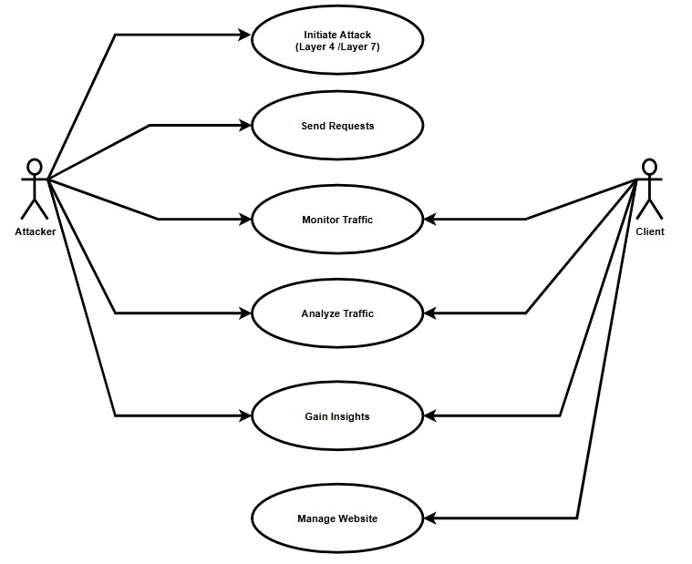
High Level Design : Use Case Diagram
Fig 1 : Use Case Diagram

Slide 18
Low Level Design : Sequence Diagram
Attack Start:
Attacker targets the website with malicious requests.
Traffic Analysis:
Website forwards data to Traffic Monitor.
Monitor analyzes traffic patterns.
Observations:
Attacker observes traffic impact.
Client checks website performance and receives updates.
Mitigation:
Client acts to manage attack effects.

Slide 19
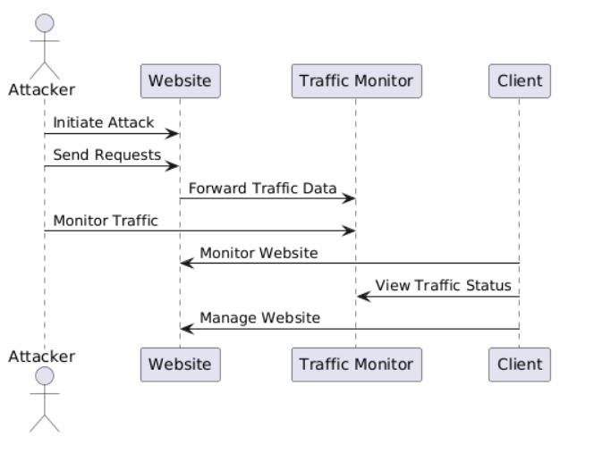
Low Level Design : Sequence Diagram
Fig 2 : Sequence Diagram

Slide 20
Low Level Design : Activity Diagram
Purpose:
Visualizes interactions among Attacker, Website, Traffic Monitor, and Client during an attack.
Flow:
Attack Initiation: Attacker targets the website.
Request Flooding: Malicious requests sent to overwhelm the site.
Traffic Monitoring: Website forwards traffic to the monitor for analysis.
Client Actions:
Monitor website status.
View traffic updates.
Take mitigation steps.

Slide 21
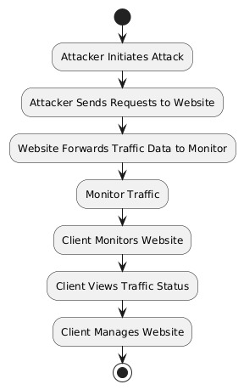
Low Level Design : Activity Diagram
Fig 3 : Activity Diagram

Slide 22
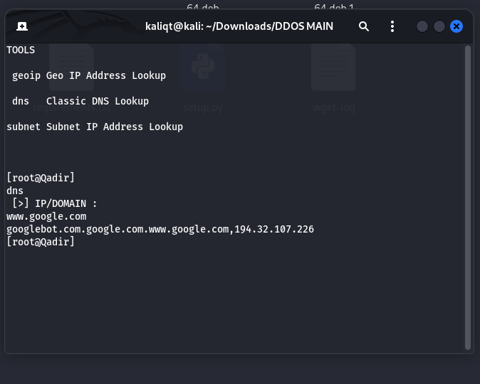
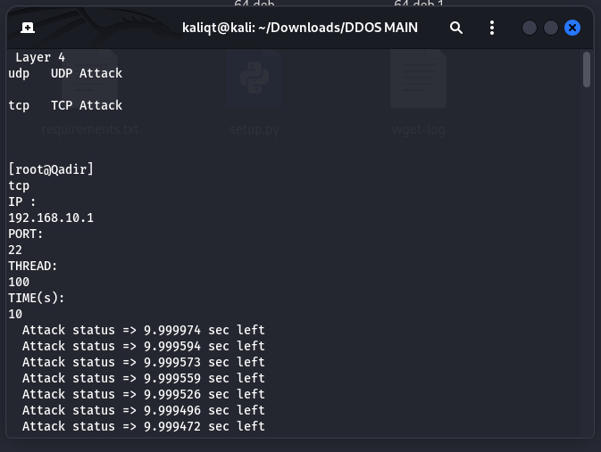
Implementation

Slide 23
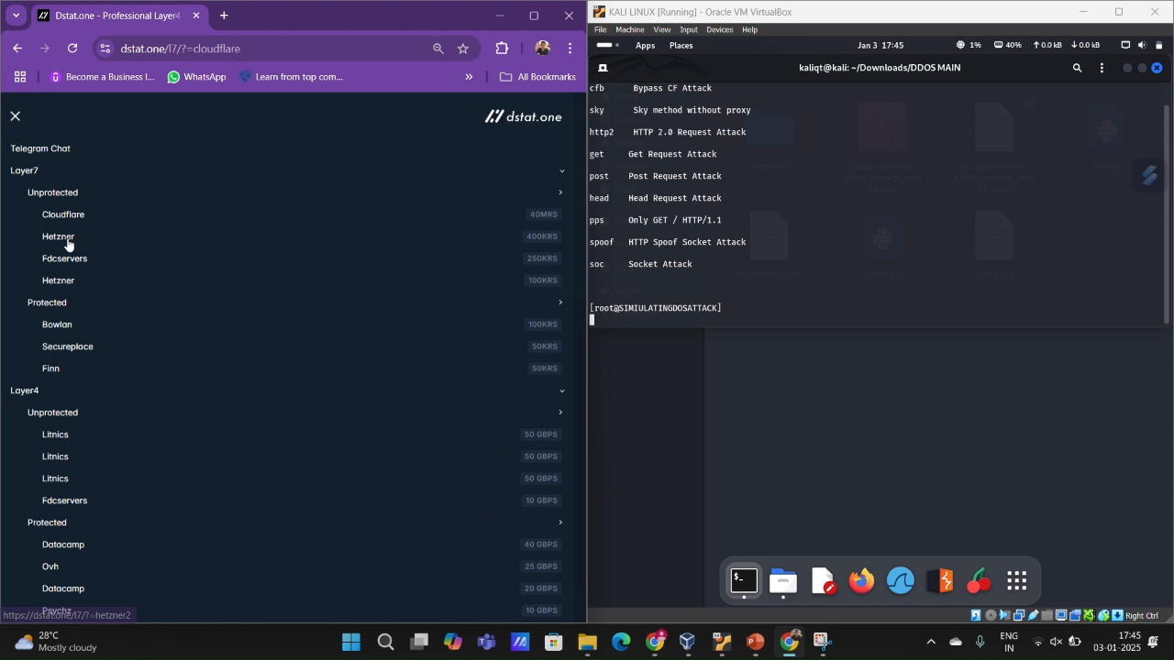
Implementation

Slide 24
Implementation
Resource Optimization: Rate
limiting and AI-based detection reduce CPU usage by up to 40% and keep memory usage increases to 30-40%.
• Traffic Management: Load balancers and CDNs
achieve a 30-50% reduction in anomalous traffic,
as demonstrated in Table 6.
• Latency and Downtime: Mitigation reduces latency during attacks to near-baseline levels, with
significant improvements in downtime, as shown
in Table 6.
• Targeted Mitigation: Each attack type benefits
from specific mitigation techniques, as summarized in Table 5, reinforcing the importance of a
tailored approach.

Slide 25
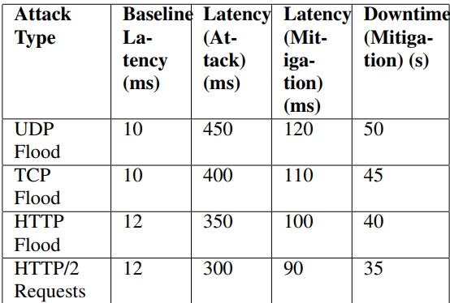
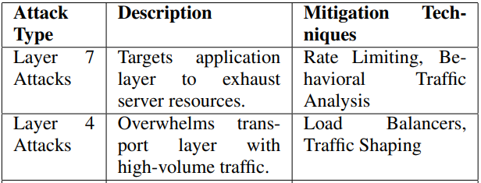
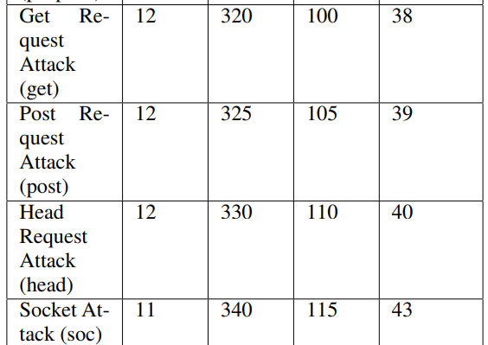
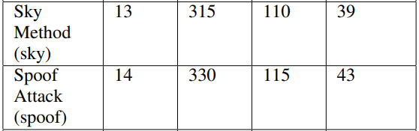
Implementation

Slide 26
Testing
Test Case ID | Test Case Description | Input | Expected Output | Pass/Fail | Remarks
TC001 | Verify that typing "help" returns a message with all valid commands. | help | HELP PANEL layer7:Show Layer7 Methodslayer4:Show Layer4 Methodstools:Show toolscredit:Show creditexit:Exit DYNAMYTE DDoS | Pass | Help command works as expected.
TC002 | Verify that an invalid command prompts a "Help" message. | udip | Invalid command. Type 'help' for a list of valid commands. | Pass | Invalid command handled correctly.
TC003 | Verify that the system can run the entire attack using one command. | python3 main.py <method> <target> <thread> <time> | Attack status and attack done | Pass | Attack initiates as expected.
TC004 | Verify that an invalid time format prompts an error message. | Time: a | ValueError: invalid literal for int() with base 10: 'a' | Pass | Invalid time format error shown.
TC005 | Verify that the cls command clears the terminal. | cls | [Terminal is cleared] | Pass | Terminal clears successfully.
TC006 | Verify that the DNS tool displays the IP address. | tools dns [>] IP/DOMAIN : www.google.com | googlebot.com.google.com.www.google.com,194.32.107.226 | Pass | DNS tool works and shows IP address.
TC007 | Verify that the TCP attack tool works. | Layer4 tcp IP:192.168.10.1PORT:22THREAD:100 TIME(s):10 | Attack status => 9.99998 sec left …..Attack status => 0.019113 sec left Attack status => 0.015828 sec left Attack Done ! | Pass | TCP attack initiated successfully.
TC008 | Verify that the UDP attack tool works. | Layer4 udp IP:192.168.10.1PORT:22THREAD:100 TIME(s):10 | Attack status => 9.97598 sec left …..Attack status => 0.0156113 sec left Attack status => 0.015828 sec left Attack Done ! | Pass | UDP attack works as expected.

Slide 27
22
Test Case ID | Test Case Description | Input | Expected Output | Pass/Fail | Remarks
TC009 | Verify that the HTTP attack tool works. | Layer7 http url:www.dstat.com/cloudfare THREAD:100 TIME(s):10 | Attack status => 9.97598 sec left …..Attack status => 0.0156113 sec left Attack status => 0.015828 sec left Attack Done ! | Pass | HTTP attack initiated correctly.
TC010 | Verify that the HTTP2 attack tool works. | Layer7 http2 url:www.dstat.com/cloudfare THREAD:100 TIME(s):10 | Attack status => 9.97598 sec left …..Attack status => 0.0156113 sec left Attack status => 0.015828 sec left Attack Done ! | Pass | HTTP2 attack initiated as expected.
TC011 | Verify that the SOC attack tool works. | Layer7 soc url:www.dstat.com/cloudfare THREAD:100 TIME(s):10 | Attack status => 9.97598 sec left …..Attack status => 0.0156113 sec left Attack status => 0.015828 sec left Attack Done ! | Pass | SOC attack works as expected.
TC012 | Verify that the GET request command works. | Layer7 get url:www.dstat.com/cloudfare THREAD:100 TIME(s):10 | Attack status => 9.97598 sec left …..Attack status => 0.0156113 sec left Attack status => 0.015828 sec left Attack Done ! Sending GET request to http://dstat/cloudfare.com... Response: 200 OK | Pass | GET request is sent and response received.
TC013 | Verify that the POST request command works. | Layer7 post url:www.dstat.com/cloudfare THREAD:100 TIME(s):10 | Attack status => 9.97598 sec left …..Attack status => 0.0156113 sec left Attack status => 0.015828 sec left Attack Done ! Sending POST request to http://dstat/cloudfare.com with data: data="test". Response: 200 OK | Pass | POST request works as expected.

Slide 28
References
[1] A. Singh and B. B. Gupta, “Distributed denial-of-service (ddos) attacksand defense mechanisms in various web-enabled computing platforms:issues, challenges, and future research directions,” International Journalon Semantic Web and Information Systems (IJSWIS), vol. 18, no. 1, pp. 1–43, 2022.
[2] S. Kumar, N. P. Singh, and N. Kumar, “Literature review of distributeddenial of service (ddos) attacks, its detection techniques and preventionmechanisms,” International Journal for Research in Applied Science andEngineering Technology, vol. 10, pp. 1681–1685, 2022.
[3] K. Huang, L.-X. Yang, X. Yang, Y. Xiang, and Y. Y. Tang, “A low-cost distributed denial-of-service attack architecture,” IEEE access, vol. 8,pp. 42111–42119, 2020.
[4] P. Kumari and A. K. Jain, “A comprehensive study of ddos attacks overiot network and their countermeasures,” Computers & Security, vol. 127,p. 103096, 2023.
[5] M. Aamir and M. A. Zaidi, “A survey on ddos attack and defense strate-gies: from traditional schemes to current techniques,” InterdisciplinaryInformation Sciences, vol. 19, no. 2, pp. 173–200, 2013.

Slide 29
References
[6] A. Cetinkaya, H. Ishii, and T. Hayakawa, “An overview on denial-of-service attacks in control systems: Attack models and security analyses,”Entropy, vol. 21, no. 2, p. 210, 2019.
[7] H. O. Jimoh and M. O. Ahmed, “Analyzing network time protocol (ntp)based amplification ddos attack and its mitigation techniques,” Journal ofDigital Innovations & Contemporary Research in Science, Engineering& Technology, vol. 12, no. 2, pp. 17–24, 2024.
[8] H. Gocher, S. Taterh, and P. Dadheech, “Reinforcing network resiliencefrom ddos: A review of advanced distributed denial of service (ddos)attacks and its mitigation techniques,” European Chemical Bulletin,vol. 12, no. 5, pp. 7178–7195, 2023.
[9] N. Tripathi and B. Mehtre, “Dos and ddos attacks: Impact, analysis andcountermeasures,” in Proceedings of the Conference on Cybersecurity,pp. 1–10, Hyderabad Central University, 2013.

Slide 30
Thank You

